Slide 1
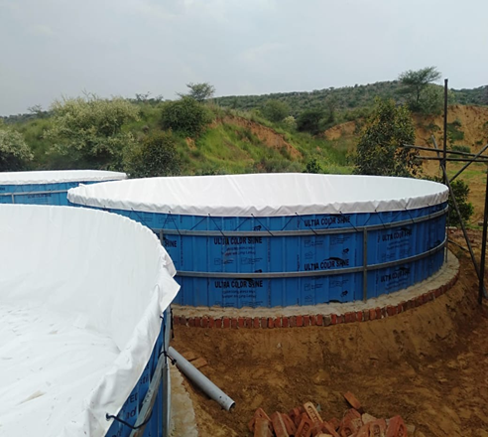
Biofloc Fish Farming for Income and Nutrition Security
A great scalable technology for post COVID-19 rural poor and entrepreneurs
August 2020

Slide 2
Structure of the Presentation
What is Biofloc Technology ……
What can we offer ……..
Operational guidelines …….
Current project …….
What we have done so far …….
Our advice if interested ………
Who are we ………

Slide 3
Biofloc Technology…..
Biofloc technology (BFT) is considered the new “blue revolution” in aquaculture and is as an environmentally friendly aquaculture technique based on in situ microorganism production.
Fish and shrimp are grown in an intensive way (minimum of 300 g of biomass per square meter with zero or minimum water exchange).
BFT aims to achieve well balanced carbon and nitrogen solution, through waste conversion into bacterial biomass from ammonium and organic nitrogenous coupled with 5 times increase in productivity compared to traditional pond culture.
Biofloc Technology offers benefits in improving aquaculture production that could contribute to the achievement of United Nations Sustainable Development Goals (SDGs) Goal 2 Zero Hunger, Goal 3 Good Health and Well-being, and Goal 12 Responsible Consumption and production.

Slide 4
Why Biofloc Technology…..
Enhanced biosecurity
Superior land and water efficiency compared to conventional system.
High density animal culture
The potential for higher production under due to efficient feed conversion, growth performance and survival rate
Zero water exchange, thus reducing environmental impact.
Lowers water pollution and controls the spread of pathogens
Lessens utilization of protein rich feed and cost of standard feed (25-30% lower).
Full cost recovery within 1 year due to high ROI (>30%)

Slide 5
What is biofloc?

Slide 6
Benefits of Biofloc
Due to high density cultivation, uses 1/6th of water and land than traditional pond
Predictable production, weekly/daily supply.
Huge local demand for fish –easy to market
110-180 days production cycle for major Indian carps
Breakeven in 3 cycles
Scale neutral suitable both for small and large landholders

Slide 7
The outcome….
We save on Feed/Money (Quite a lot!)
Accumulation of toxic residues (Sulphides, Ammonia etc) is minimised.
Fish growth is boosted by intensified fish farming.
Creation of new employment in the rural areas.
More income, more food for all.

Slide 8
Who are we….
Partners in Prosperity (PnP) (www.pnpindia.in) a non-profit institution engaged in developing pro-poor agricultural value chain.
We are value driven enablers who specialise in system level approaches to analyze complexities, develop solutions and help implement the same towards achieving equitable economic and social development outcomes, in pursuing Sustainable Development Goals.
Established in 1998, Partners in Prosperity (PnP) is registered as non-profit entity, under the Societies Registration Act of 1860, Delhi. PnP is authorized to receive foreign contribution and exempted from Income Tax under Section 12A and 80G.
Vision: A healthy and prosperous planet, and people (HP3).
01
Mission: To sustainably alleviate poverty, build healthy environment and secure livelihoods for all, in partnership with governments, communities, enterprises and other institutions.
02

Slide 9
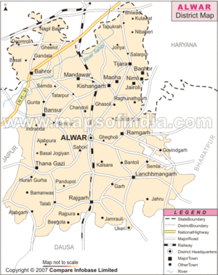
Current Project…..
Partners in Prosperity and Kibo Foods Private Limited, a for-profit company has joined hands to develop fish farming.
The first project is in Muradwas village, Tijara Tehsil of Alwar district in Rajasthan located in the semi arid foothills of Aravalli.
Ground water in Tijara is over exploited. It is hoped that fish farming will reduce the draft to a sustainable level.
Proximity to Bhiwadi, Rewari, Alwar and Delhi offers excellent market opportunity.

Slide 10
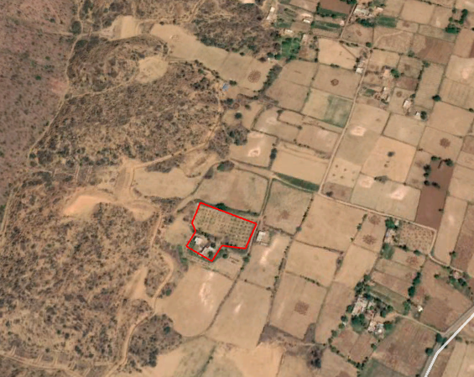
Location of the Biofloc Unit in Tijara…..

Slide 11
What can we offer…
Organizing groups of entrepreneurs and women farmers for adopting bio floc production
Capacity building of farmers in bio floc fish farming
Documentation of success stories.
Training of bio floc entrepreneurs and farmers in entrepreneurship, bio floc operations, financial management and record keeping
Liaising with financial institutions

Slide 12
If interested……
Certified Training – Content
An Introduction to Biofloc Fish Farming in India
Tank Construction
Biofloc Operations
Economics of Biofloc Farming
Fish Health Management
Financial Assistance for Biofloc
Fish Marketing
How to Fermented Carbon Organic (FCO) and Fish Feed at Home
Training Modules *
Field visits to biofloc fish farmers
Visit to banks and financial institutions
Interaction with successful entrepreneurs
Additional Services
* Certificate issued by Partners in Prosperity Society, Delhi

Slide 13
Biofloc Operations guidelines….
Step 1
Organise Biofloc Material, Accessories, and Tools
Step 2
Ensure 24/7 Aeration
Step 3
Water Preparation Process with beneficial microbes
Step 4
Species selection and stocking densities
Step 5
Balancing Carbon Source Addition
Step 6
Monitoring Biofloc Growth
Step 7
Water Parameters and Associated Farm Infrastructure
Step 8
Disease and Morbidity Control
Step 9
Monitoring of Fish Stock
Step 10
Harvest, clean-up, and discharge of water

Slide 14
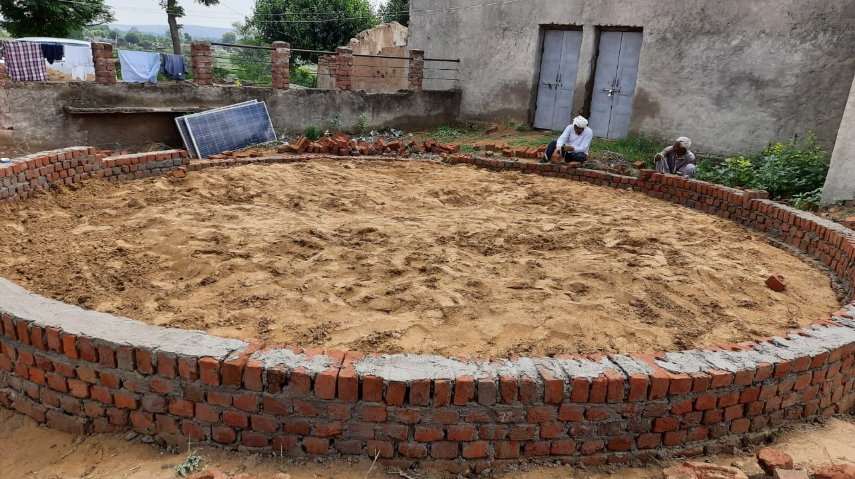
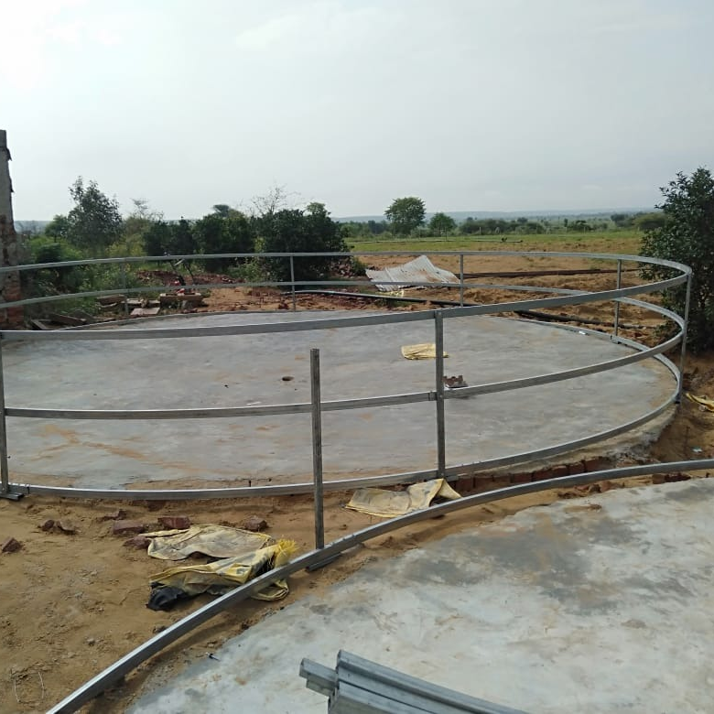
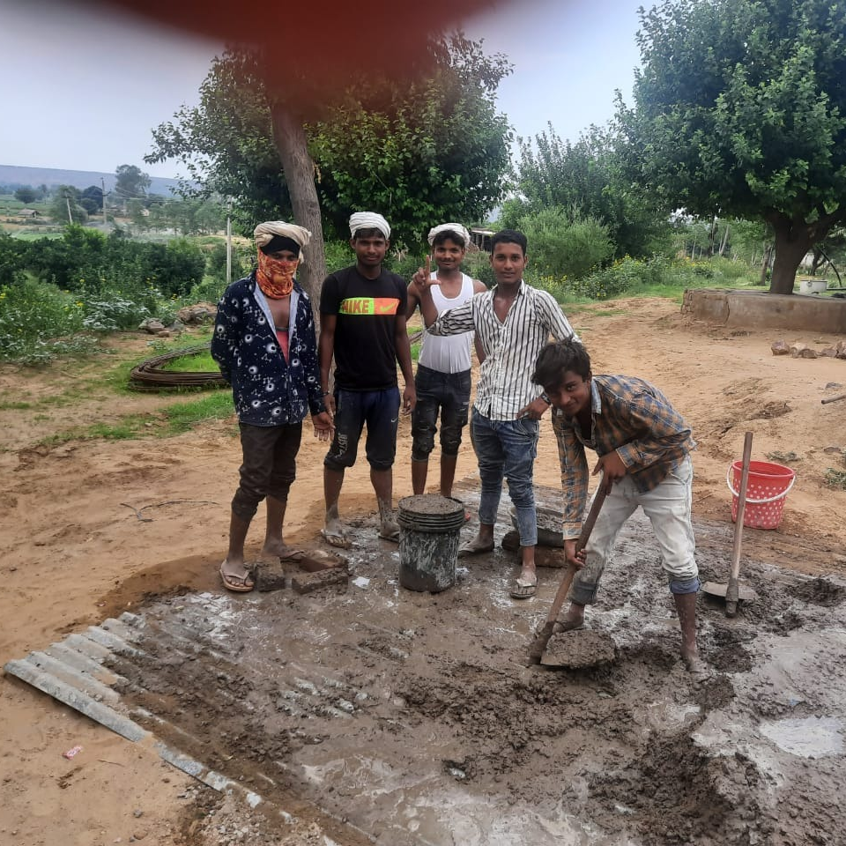
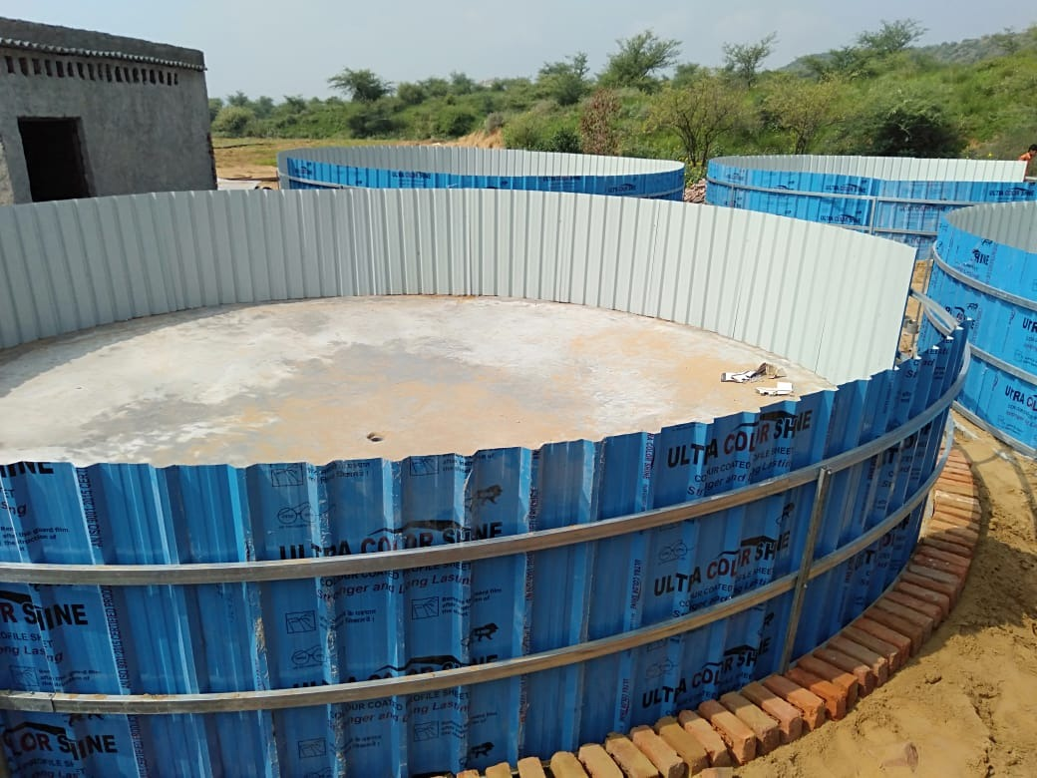
What we have done so far….
Produced a Resource Book on Biofloc Fish Farming (https://e33f589c-3906-4339-bd77-7de74b53c6fe.filesusr.com/ugd/a9d8e9_f5ec819e8c9c40fe94947cf9267574e1.pdf )
Using own resources installed in July 2020 4 tanks of 50K litres in Tijara, Dt. Alwar, Rajasthan
Trained 5 Master Trainers and 10 masons and plumbers in biofloc tank construction and installation
Thoroughly researched and understood the needs of small producers, bottlenecks in the supply chain and their solution.

Slide 15
Our advice if you are interested….
Start small
Large tanks are more profitable than small tanks
Biofloc fish farming requires technical skills, venture only when you have sufficient knowledge, skills, money, and mental determination to succeed
You can easily earn a return of 20-30% on your investment, other things being equal

Slide 16
Email:info@pnpindia.org.in
Website: www.pnp.in

Slide 17
Extra Slides

Slide 18
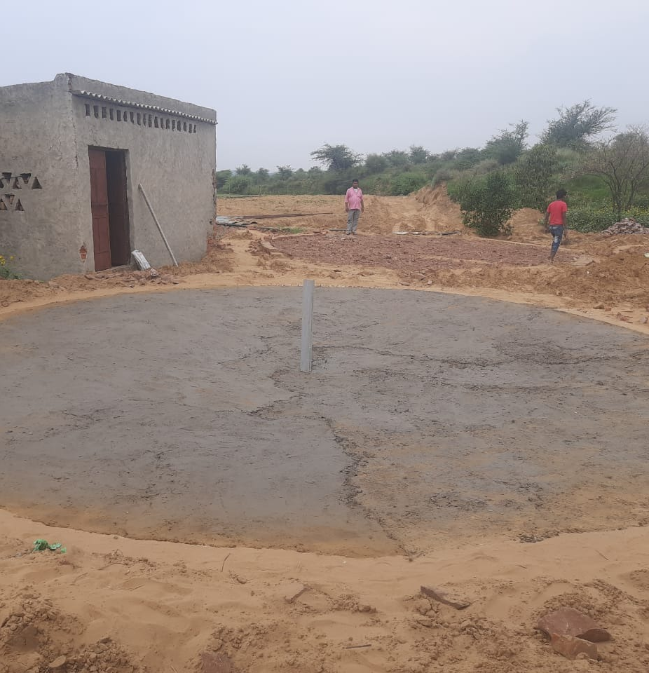
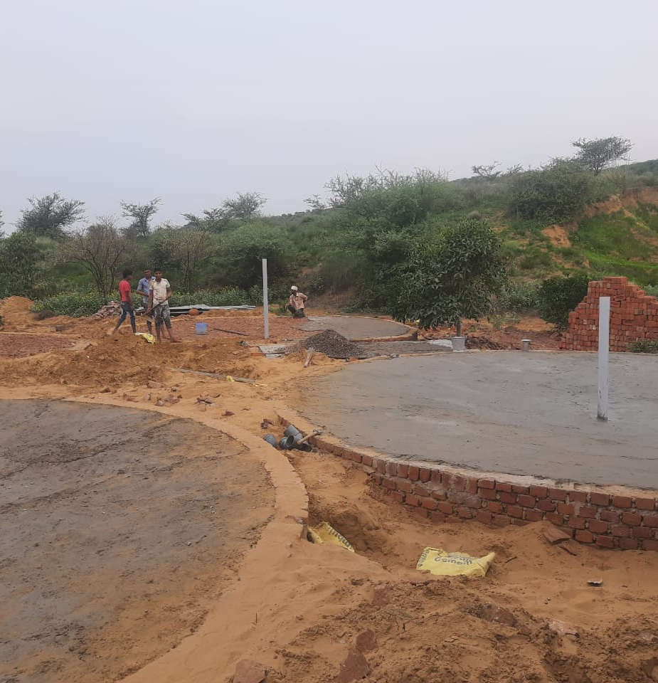

Slide 19
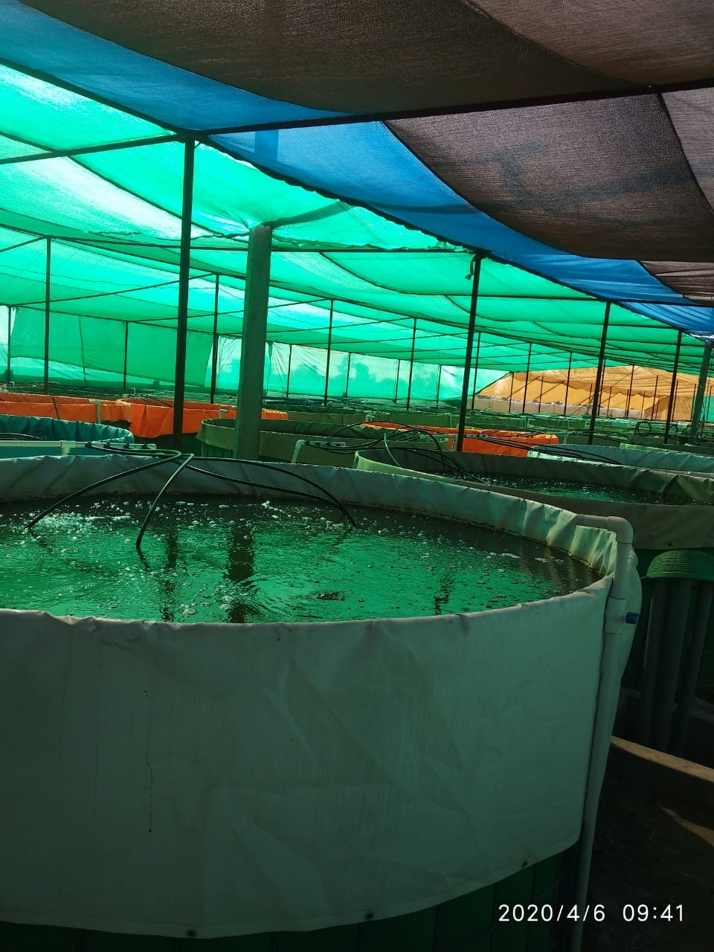
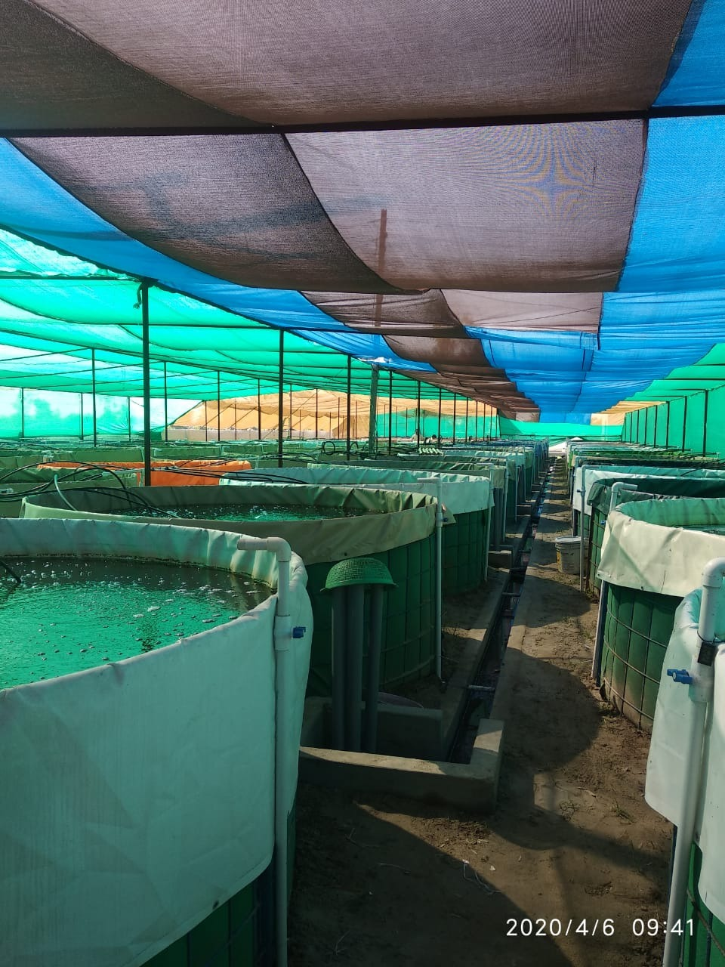

Slide 20
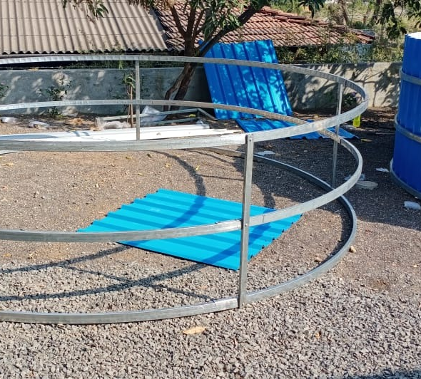
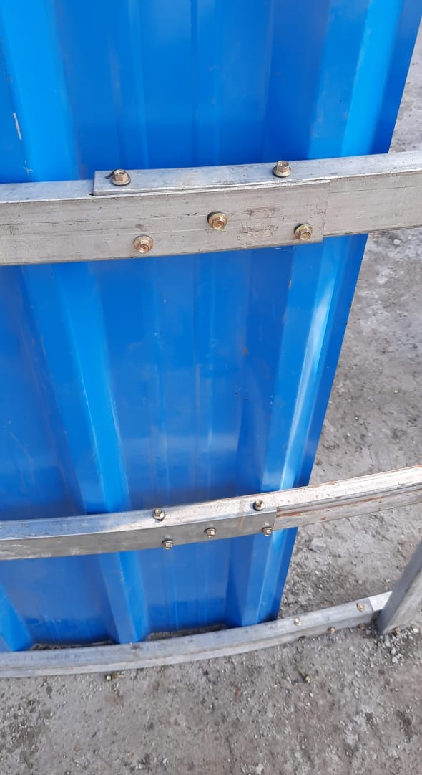
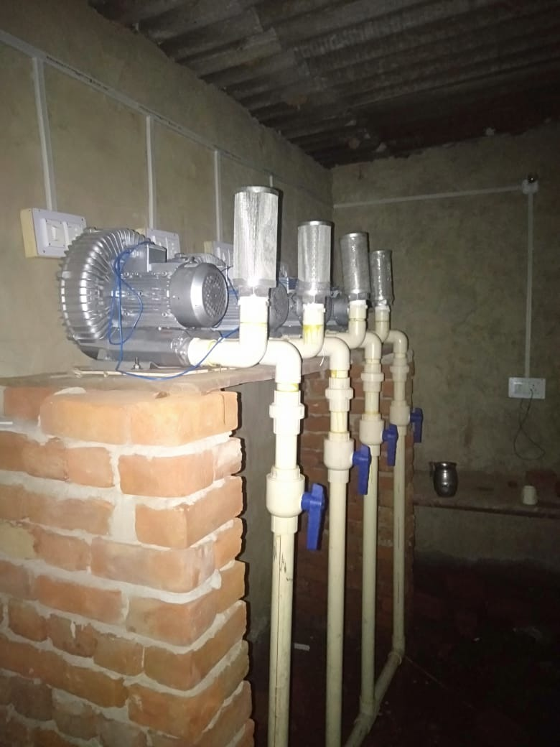
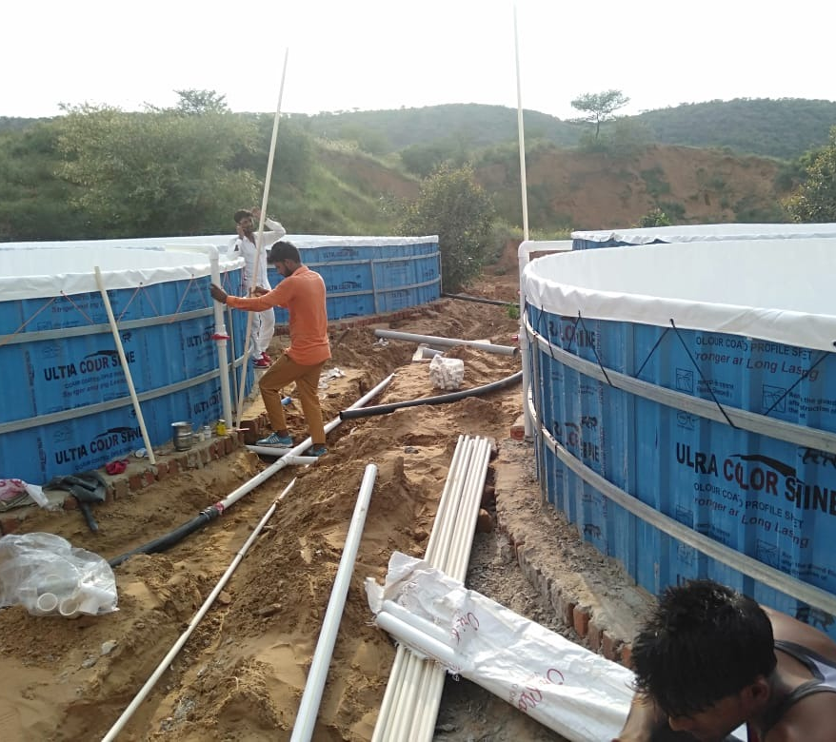

Slide 21
